Slide 1

Climate Change Research at TTU: potential for collaborations to build a better future
Nick Smith
Associate Professor, Biology
Director, TTU Climate Center
nick.smith@ttu.edu
Climate Center

Slide 2
Outline
Brief introduction to me and my background
TTU Climate Center
Who we are
What we do
Where we are going
Time for discussion
Climate Center
nick.smith@ttu.edu

Slide 3
Outline
Brief introduction to me and my background
TTU Climate Center
Who we are
What we do
Where we are going
Time for discussion
Climate Center
nick.smith@ttu.edu

Slide 4
Nick’s background
PhD from Purdue University in Biology (2016)
Postdoctoral training at Lawrence Berkeley National Lab (2017)
Tenure track at TTU in Biology since 2017
Appointed Climate Center Director in 2024
Expertise
Plant ecophysiology
Terrestrial ecosystem ecology
Biosphere-atmosphere feedbacks
Climate Center
nick.smith@ttu.edu

Slide 5
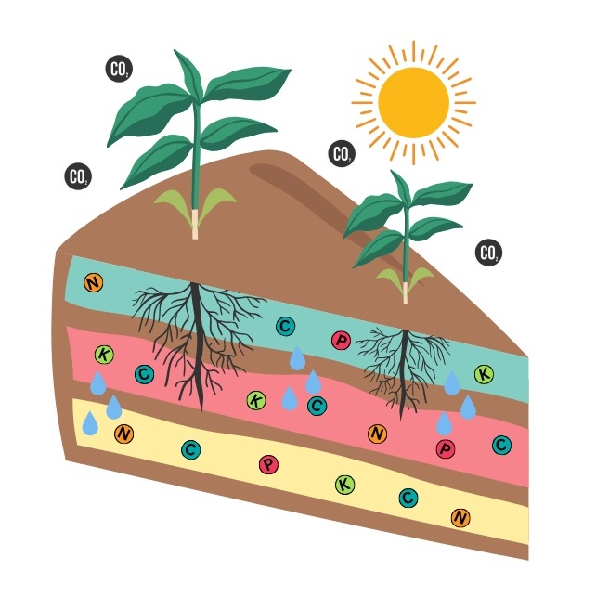
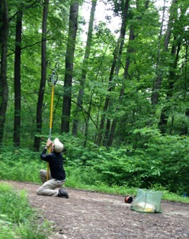
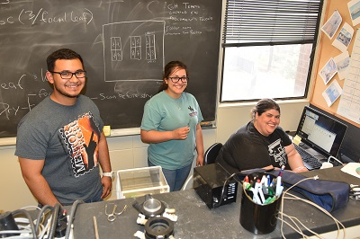
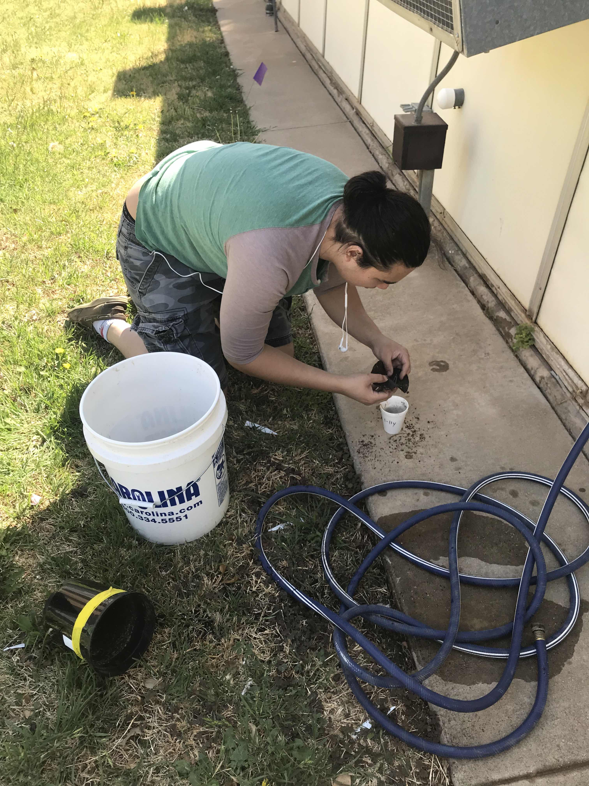
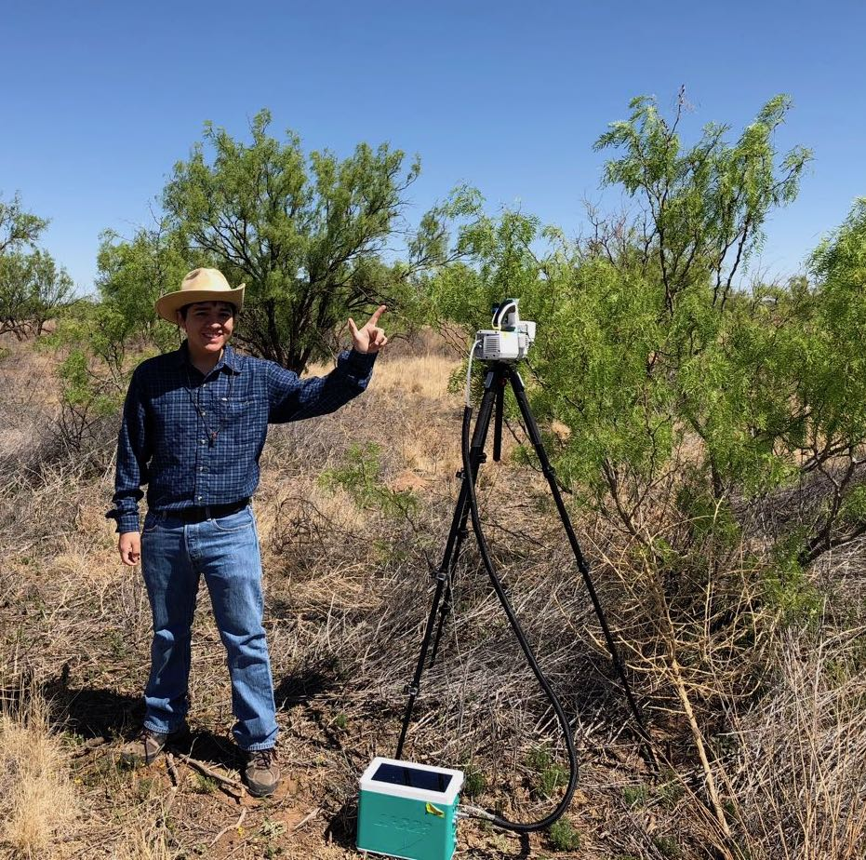
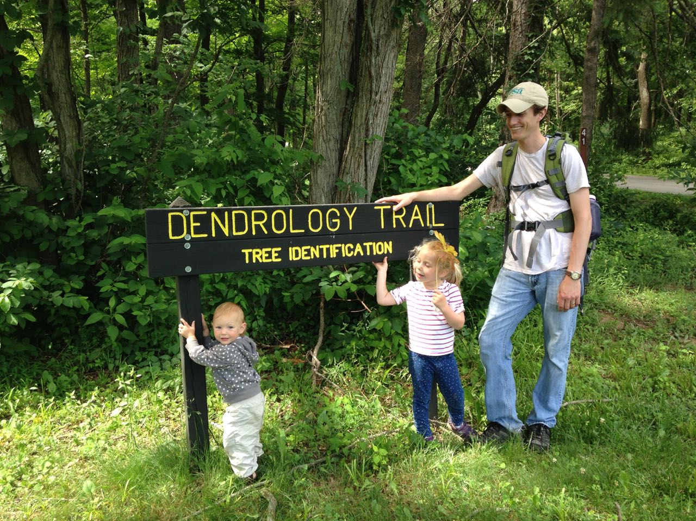
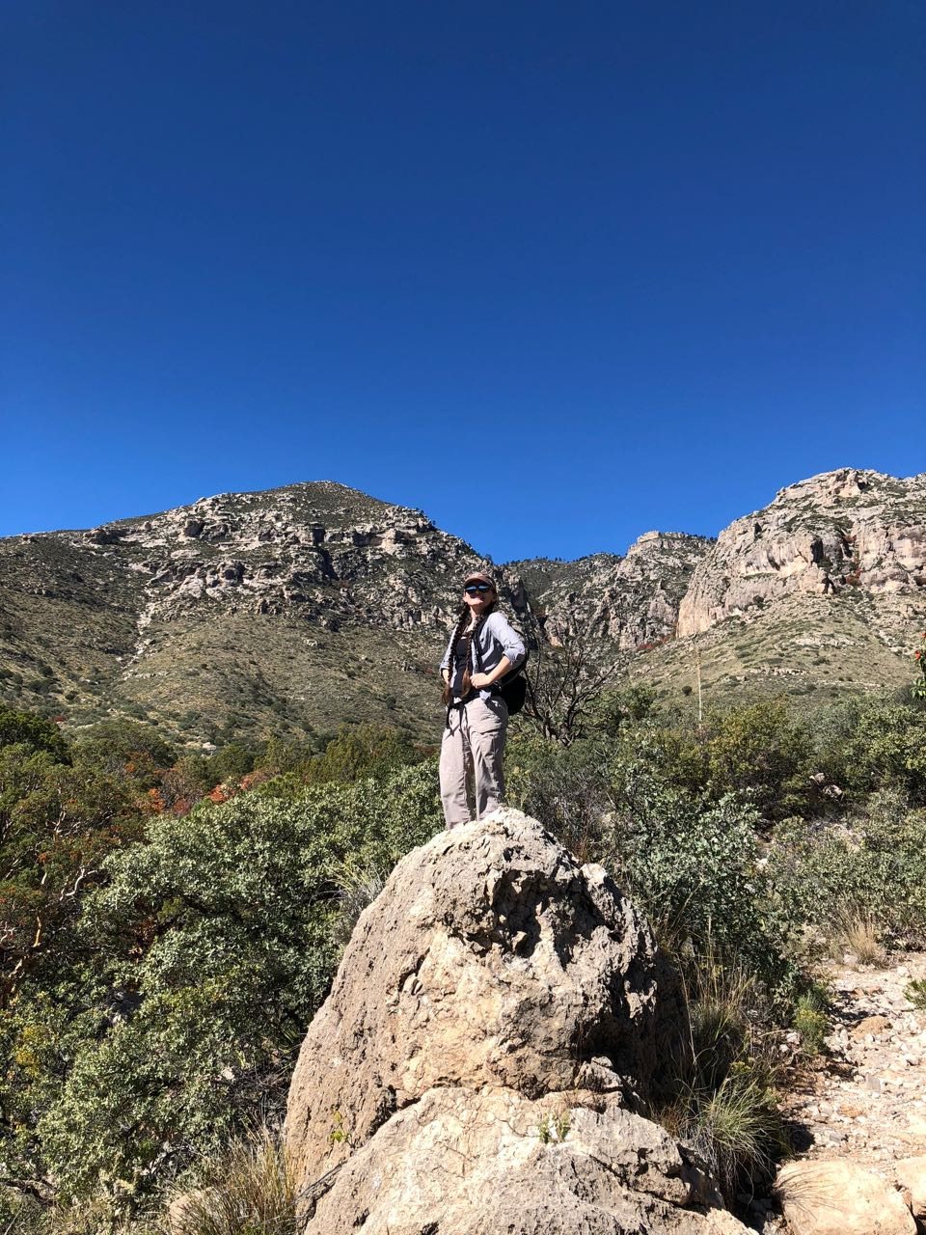
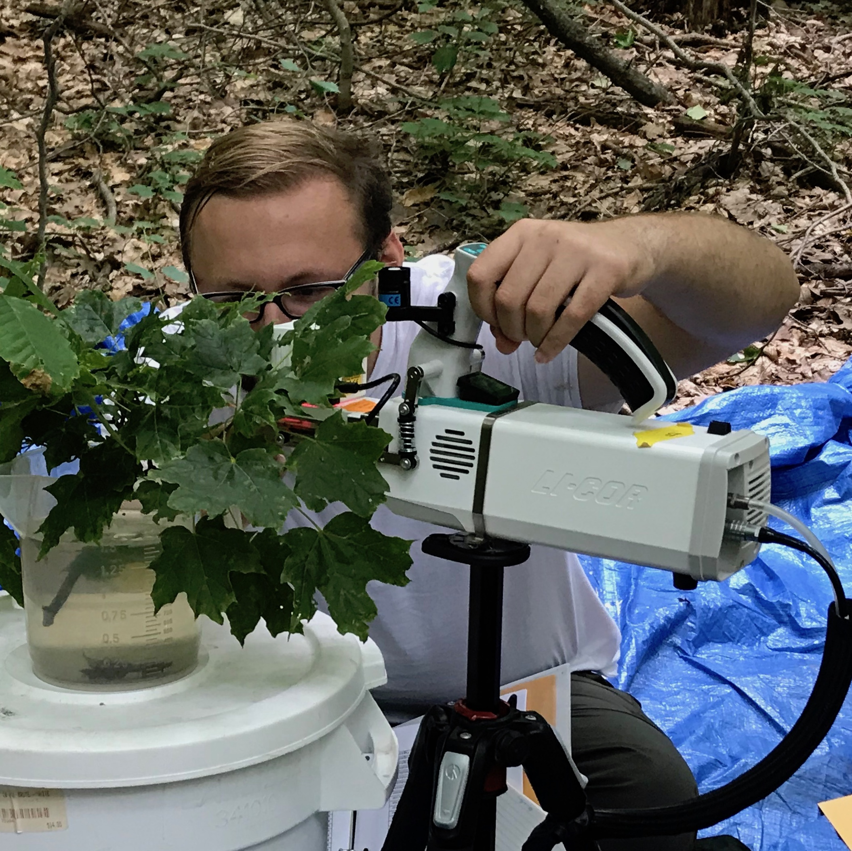
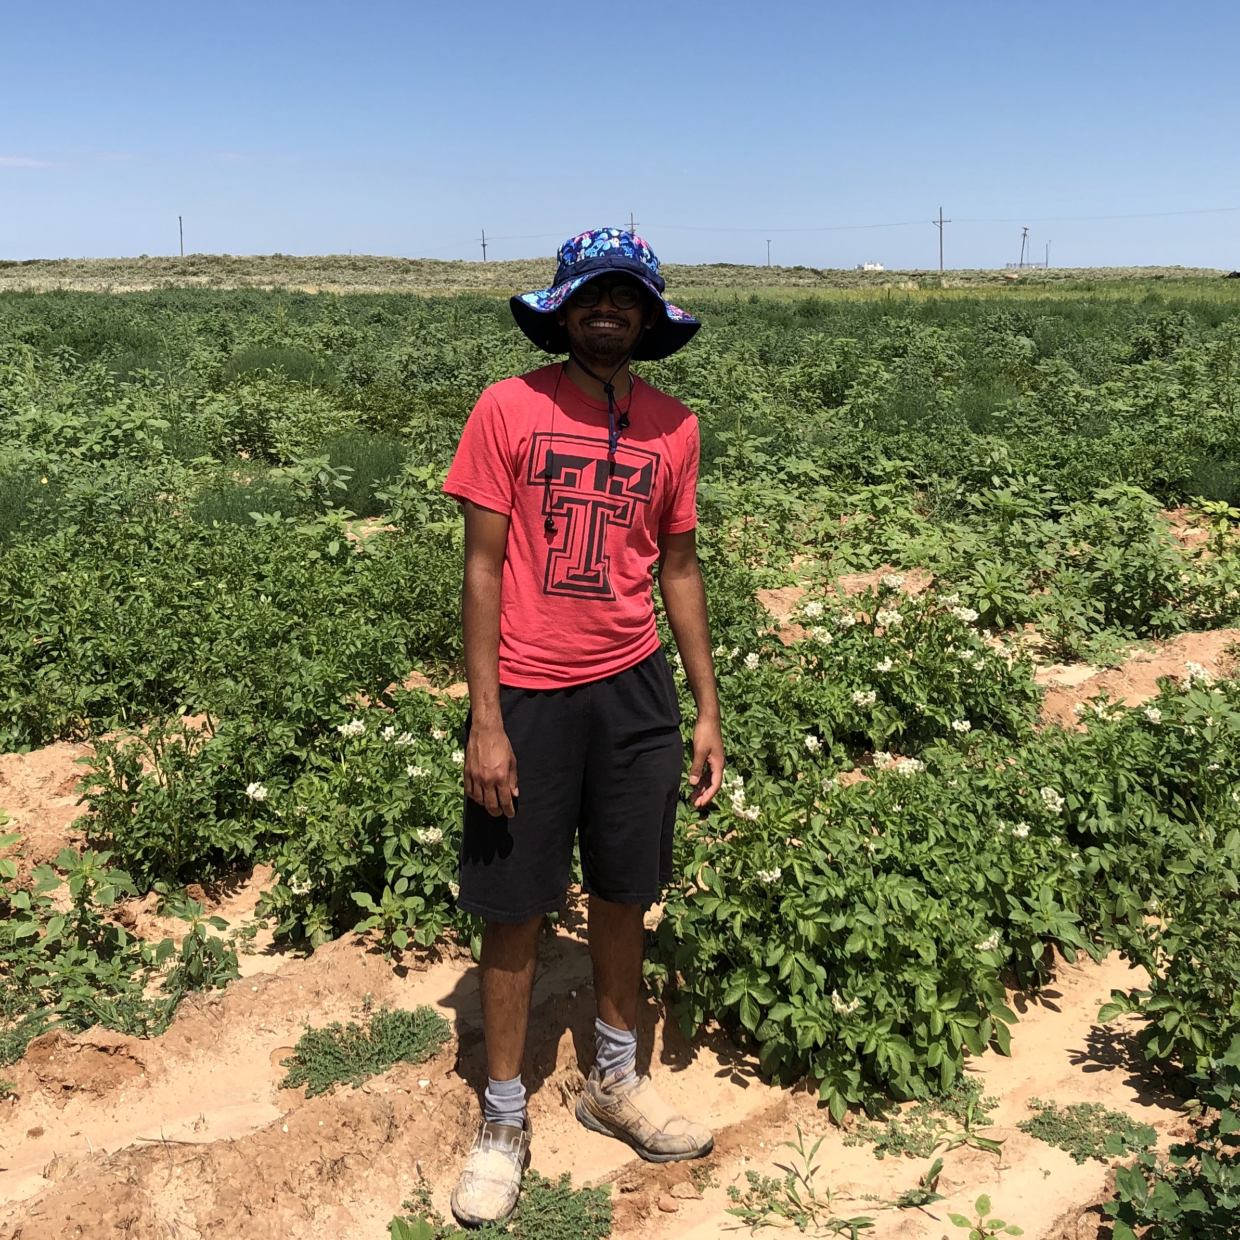
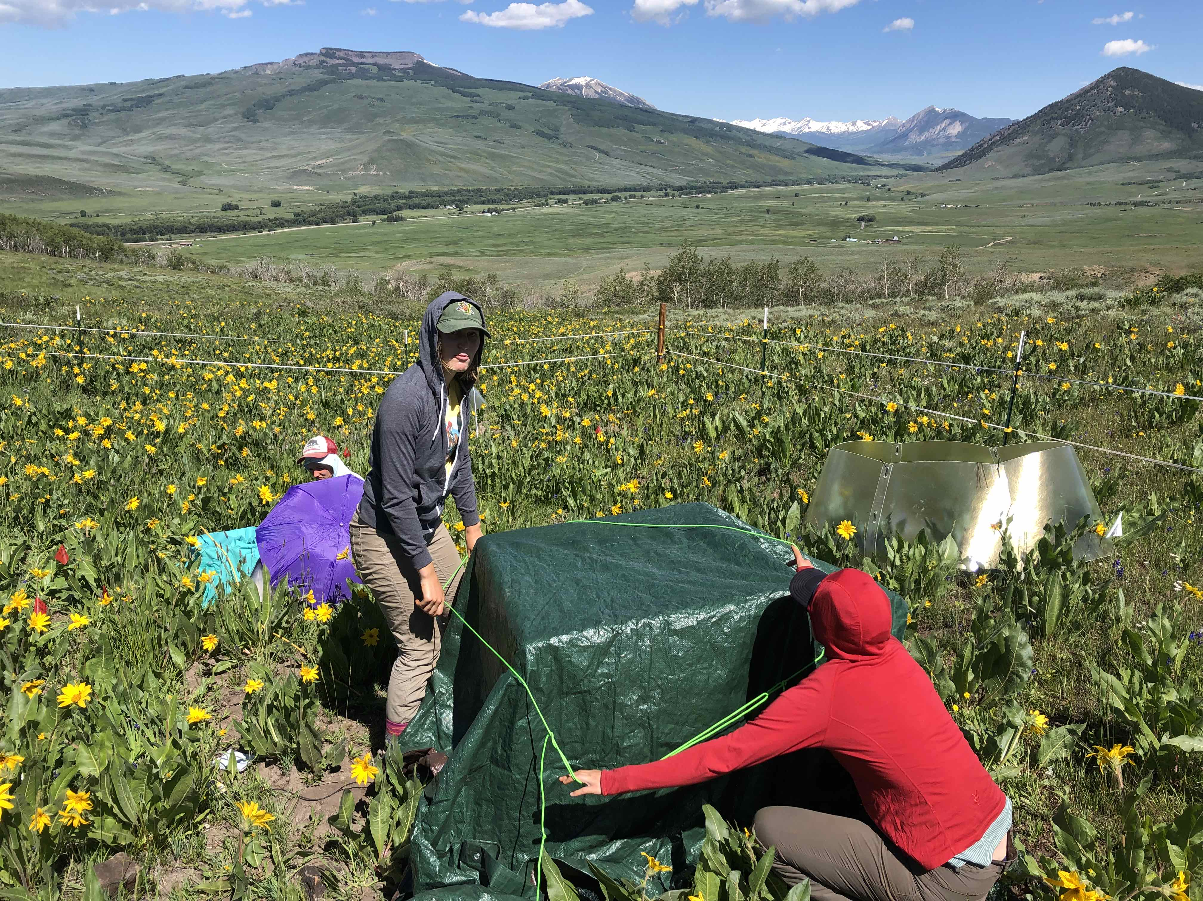
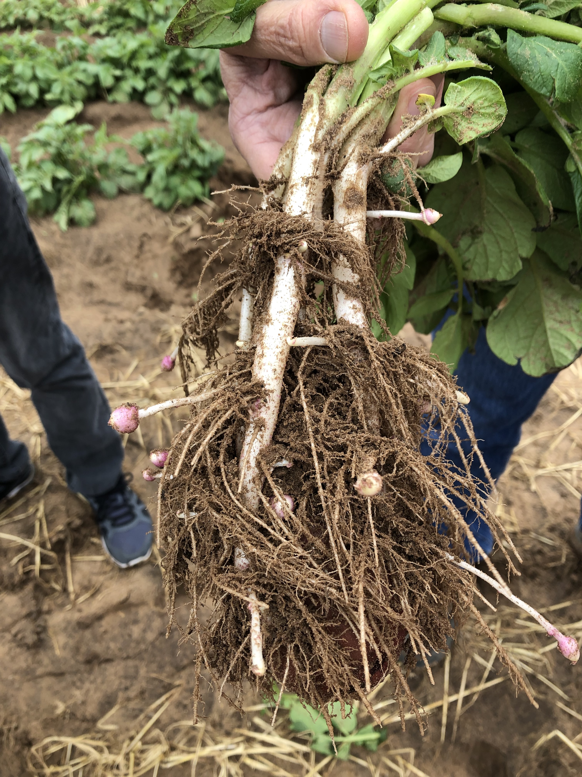
PhUnFETTy Lab: overview
PHysiology for UNderstanding the Functioning of Ecosystems at TTU
Feedbacks between global change, plants, and ecosystem services
Focus on plant physiology: what do plants do and does it matter?
Climate Center
nick.smith@ttu.edu

Slide 6
PhUnFETTy Lab: current projects
LEMONTREE: Land Ecosystem Models based On New Theory, obseRvations, and ExperimEnts
Funding: Schmidt Futures, $10 million/$800k to TTU (2020-2025)
Goal: develop a terrestrial biosphere model from first principles
Improving understanding and prediction of photosynthetic acclimation to global change
Funding: US Natl. Science Foundation, $1.1 million/100% TTU (2021-2026)
Goal: improve understanding and ability to predict photosynthesis
Defining the mechanisms and consequences of mutualism reorganization in the Anthropocene
Funding: US Natl. Science Foundation, $3.6 million/$1.2 million to TTU (2022-2027)
Goal: understand mechanisms underlying plant species invasion

Slide 7
Outline
Brief introduction to me and my background
TTU Climate Center
Who we are
What we do
Where we are going
Time for discussion
Climate Center
nick.smith@ttu.edu

Slide 8
Outline
Brief introduction to me and my background
TTU Climate Center
Who we are
What we do
Where we are going
Time for discussion
Climate Center
nick.smith@ttu.edu

Slide 9
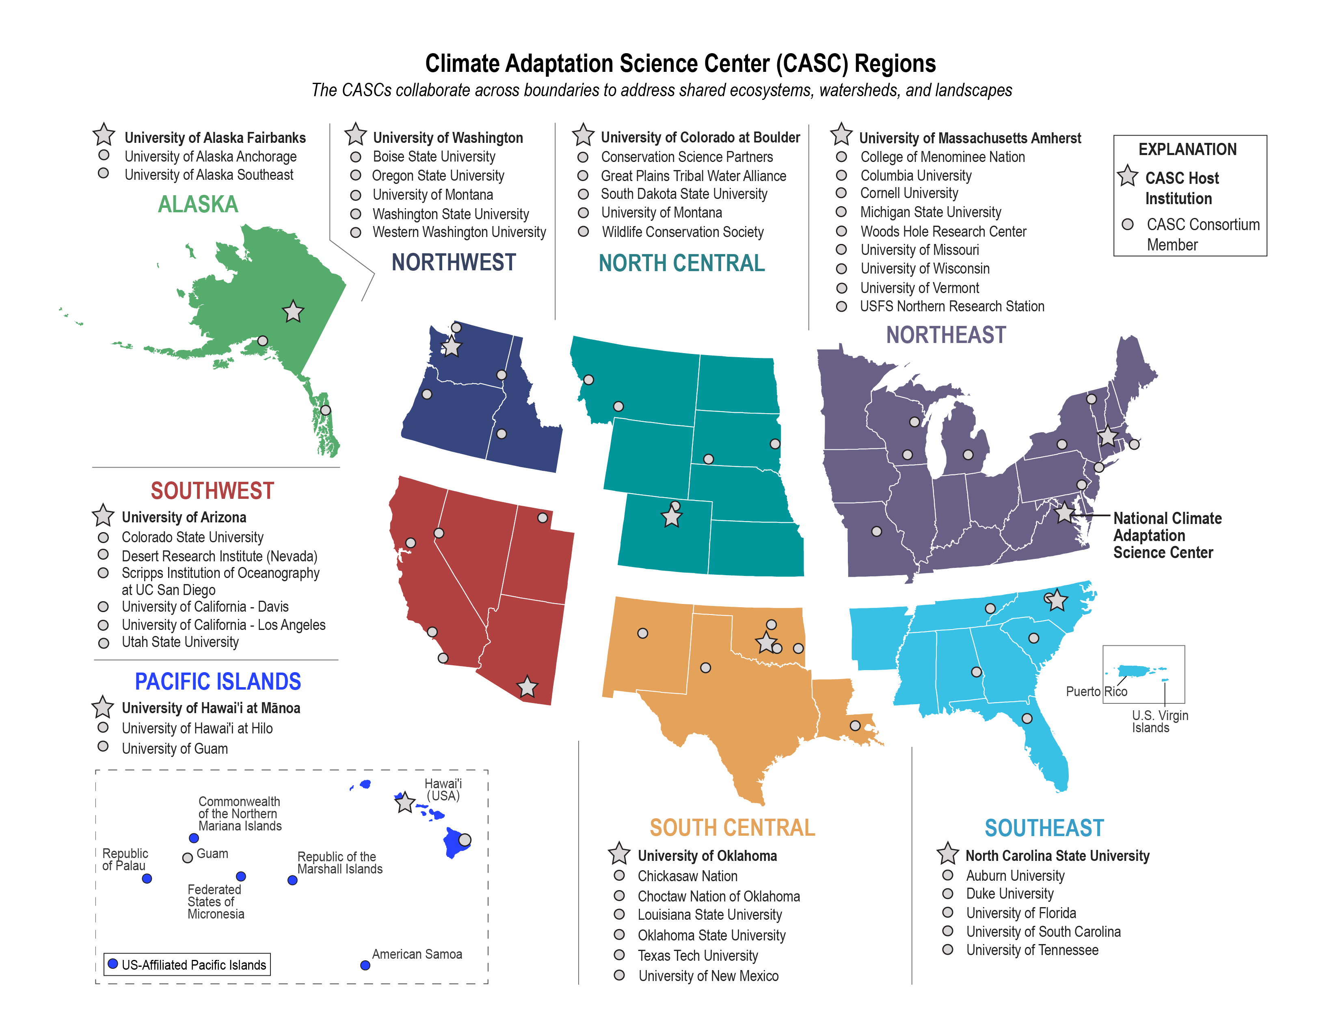
TTU Climate Center: Who we are
Member of USGS-funded Climate Adaptation Science Centers (CASCs)
Climate Center
nick.smith@ttu.edu

Slide 10
TTU Climate Center: Who we are
Consortium institution of the South Central CASC (SC-CASC)
Climate Center
nick.smith@ttu.edu

Slide 11
TTU Climate Center: Who we are
SC-CASC:
Provide decision makers with the science, tools, and information they need to address the impacts of climate variability and change
Transform how climate science is conducted and applied in the south-central US
Support big thinking, including multi-institutional and stakeholder-driven approaches to assessing the impact of climate on natural and cultural resources
Climate Center
nick.smith@ttu.edu

Slide 12
TTU Climate Center: Who we are
>100 active members
Mostly faculty
Students and postdocs
12 TTU Colleges
36 TTU Departments
Open to anyone interested in, passionate about, or doing climate-related work
Climate Center
nick.smith@ttu.edu

Slide 13
Outline
Brief introduction to me and my background
TTU Climate Center
Who we are
What we do
Where we are going
Time for discussion
Climate Center
nick.smith@ttu.edu

Slide 14

TTU Climate Center: What we do
Serve as regional hub for climate change
Work with community members and stakeholders
All areas of research that intersect with climate
Monthly research and outreach meetings
Events
Informational events on and off campus
Science by the Glass
Climate Center
nick.smith@ttu.edu

Slide 15
Outline
Brief introduction to me and my background
TTU Climate Center
Who we are
What we do
Where we are going
Time for discussion
Climate Center
nick.smith@ttu.edu

Slide 16
TTU Climate Center: Where we are going
Goal: bolster climate-related research and outreach at TTU
Climate Center
nick.smith@ttu.edu

Slide 17
TTU Climate Center: Where we are going (research)
Fostering interdisciplinary collaborations
Physical climate science (ala IPCC WG1)
Climate impacts (ala IPCC WG2)
Climate mitigation and adaptation (ala IPCC WG3)
Engaging with stakeholders
Promoting research
Climate research symposium (AY 2024-25)
Enhancing student education
Travel grants
Research scholarships
Climate Center
nick.smith@ttu.edu

Slide 18
TTU Climate Center: Where we are going (research)
Would love to see us expand our scope and develop more international projects!
Foster interdisciplinary collaborations
Physical climate science (ala IPCC WG1)
Climate impacts (ala IPCC WG2)
Climate mitigation and adaptation (ala IPCC WG3)
Engage with stakeholders
Promoting research
Climate research symposium (AY 2024-25)
Enhancing student education
Travel grants
Research scholarships
Climate Center
nick.smith@ttu.edu

Slide 19
TTU Climate Center: Where we are going (outreach)
Continue ongoing outreach activities
Science by the Glass
Tabling events
Engage more with students
Sponsored events
Research integration opportunities
Engage more with local, state, national, and international communities
Social media
Climate Center
nick.smith@ttu.edu

Slide 20
Outline
Brief introduction to me and my background
TTU Climate Center
Who we are
What we do
Where we are going
Time for discussion
Climate Center
nick.smith@ttu.edu

Slide 21
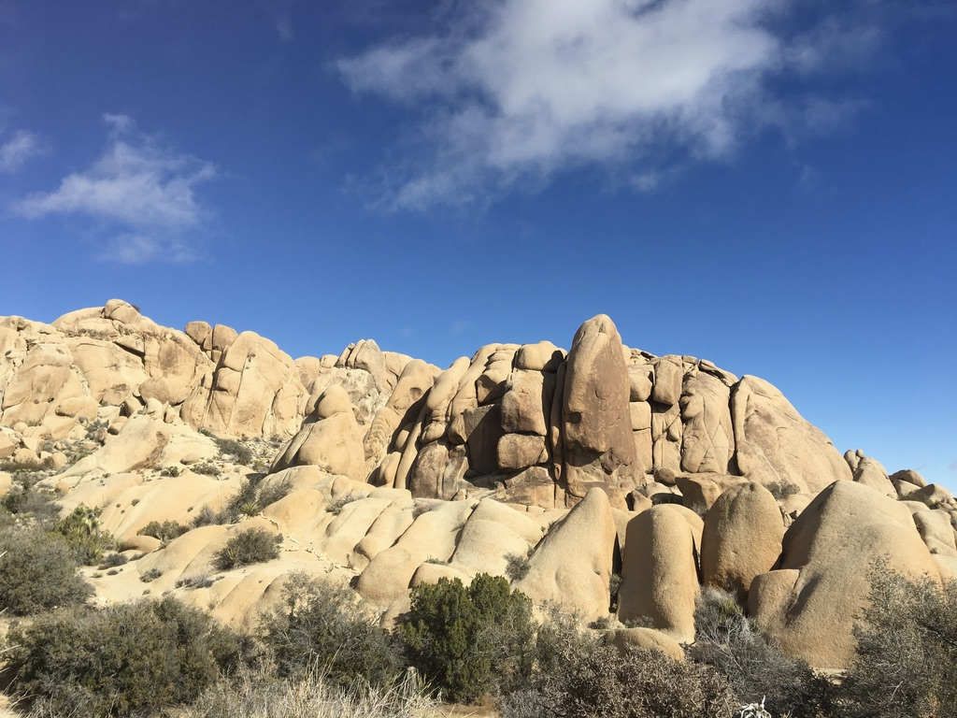
Presentation available at:
www.github.com/SmithEcophysLab/seminar/2024_cars
Let’s chat!
Climate Center
nick.smith@ttu.edu

